Slide 1
Online Survey System
PSG Tech Student-Teacher Feedback Collection

Slide 2
Primary Modules
Login Screen
Feedback Form (Student’s Login)
List of faculty to be rated by that student
Feedback Form with various queries
Report Generation and assessment (Teacher’s Login)

Slide 3
Login Screen
Flow:
Select Staff or Student login.
Enter Staff/Student ID and Password.
Click ‘Login’.
If ID and Password matches, direct to Feedback Page.
If ID and Password fails to match, throw error dialog. Direct to Login Page.

Slide 4
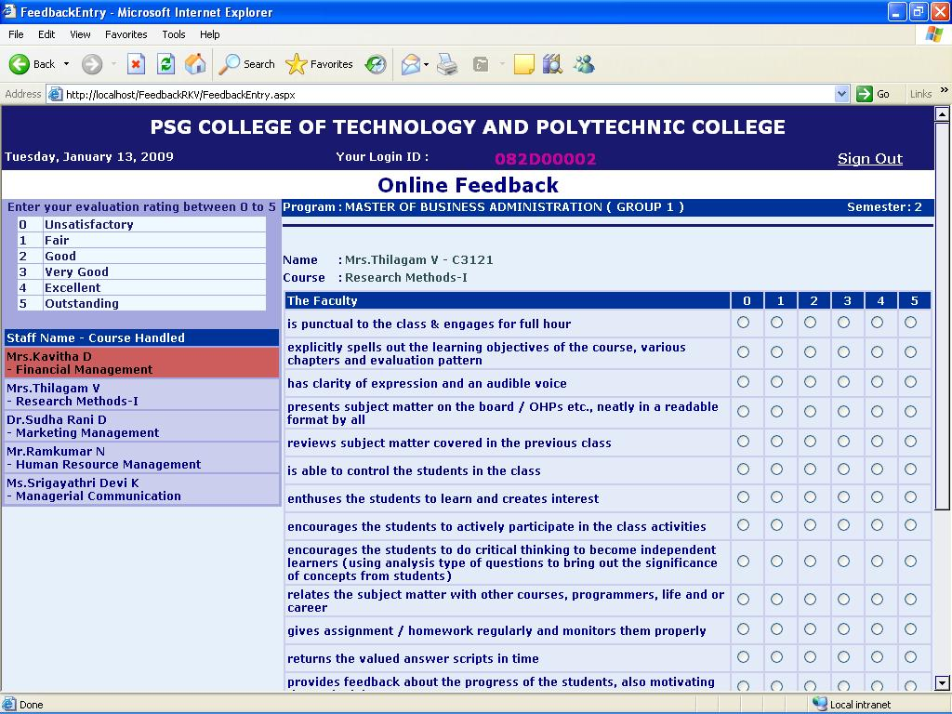
Feedback Form – Student Login
Flow:
List of staff to be rated by the student
From the list of staff, student selects one.
A list of queries are displayed, for which the student provides rating from 0 to 5.

Slide 5
Feedback Form – Student Login
Flow:
After rating a particular staff, the student clicks ‘Save’
Similarly, other teachers are rated
Upon rating all the staff, the student submits the feedback
The feedback is stored under a dummy number
A compiled report can be obtained by a staff in his Login.

Slide 6
Feedback Page

Slide 7
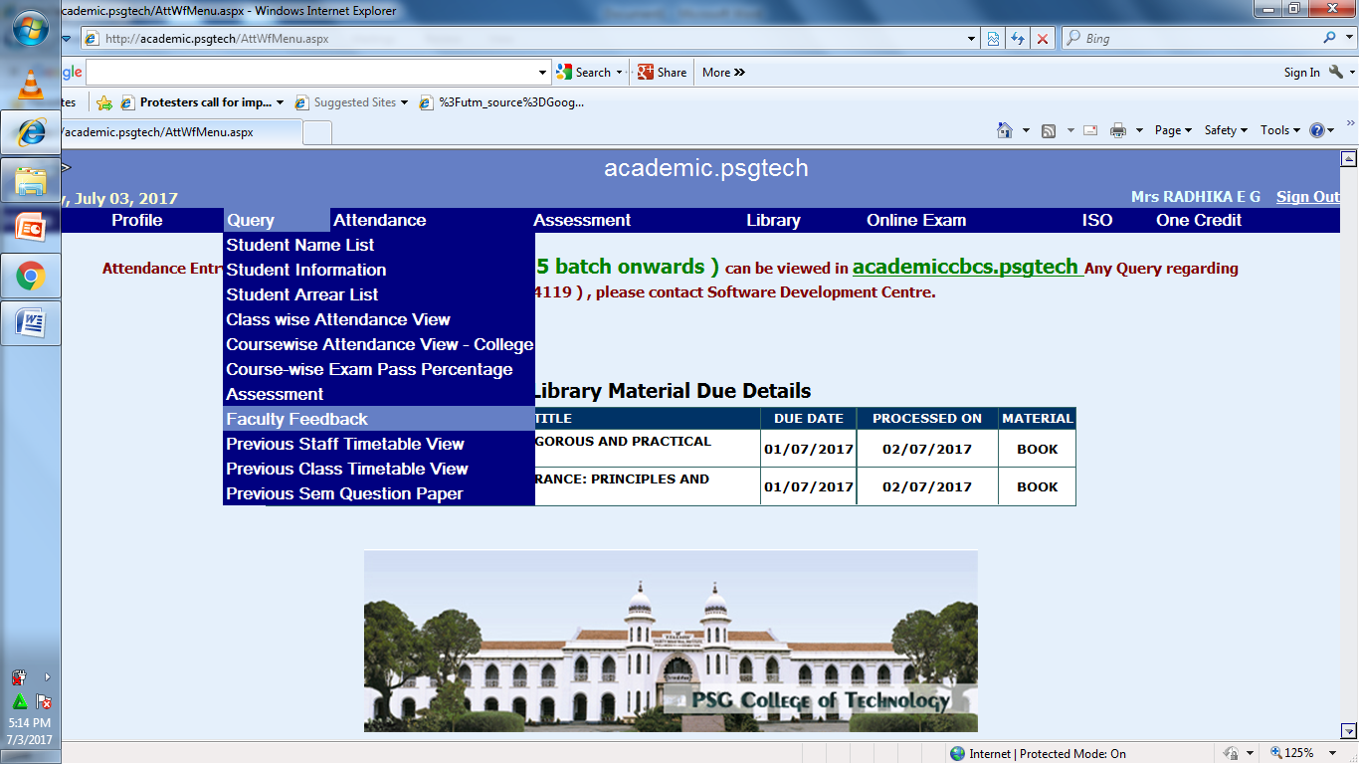
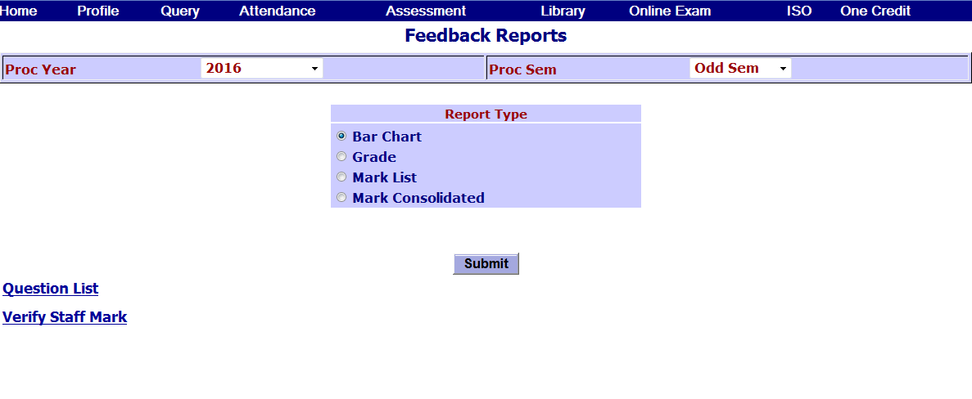
Report Generation - Staff Login
Flow:
Login using a Staff Login.
Access Faculty Feedback option.
Select a report type.
Types of report available:
Bar Chart
Grade
Mark list
Mark Consolidated.

Slide 8
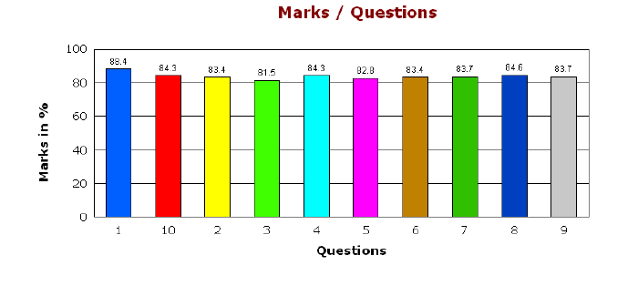
Report Generation – Bar Chart
Flow:
Bar Chart displays percent rating of marks for each questions.
Proving rating for individual questions relatively in percent, helps the faculty to improve on these areas.

Slide 9
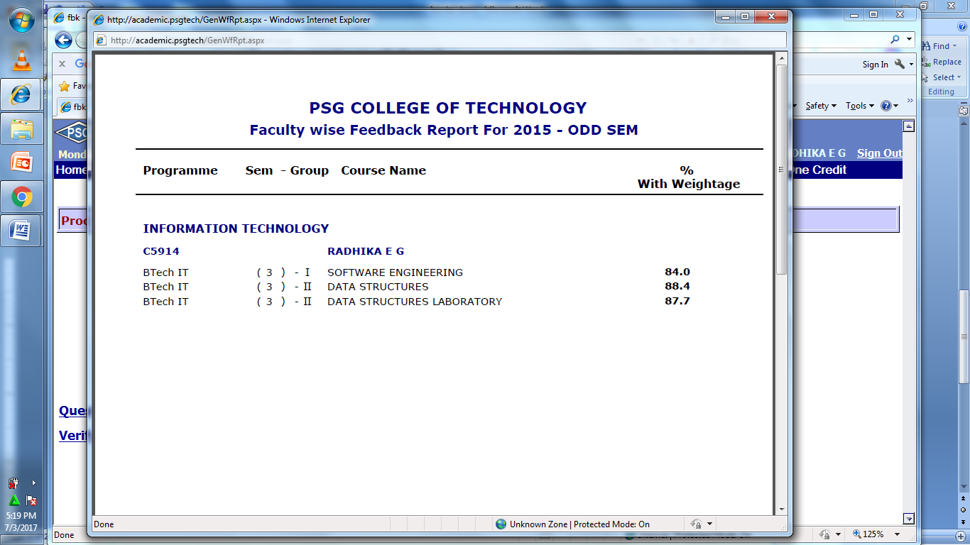
Report Generation – Grade
A staff may handle various subjects in a particular semester.
This view give the report of performance in various subjects as Percent with weightage.

Slide 10
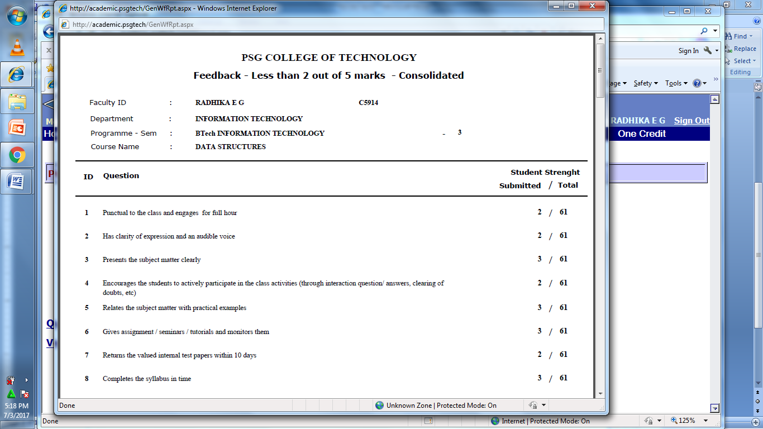
Report Generation – Mark List
It is also possible to perform various queries on the collected feedback
Number of students who have given a poor rating, can be easily viewed.
Enables the faculty to analyze ratings of various ranges.

Slide 11
Report Generation – Mark Consolidated
This provides detailed report of rating, no of students rated, average marks and percent marks.
High priority areas can be given higher weightage, improving rating system.
Percent marks is similar to the bar chart view seen above.
Percentage of mark provides the overall rating of a Staff

Slide 12
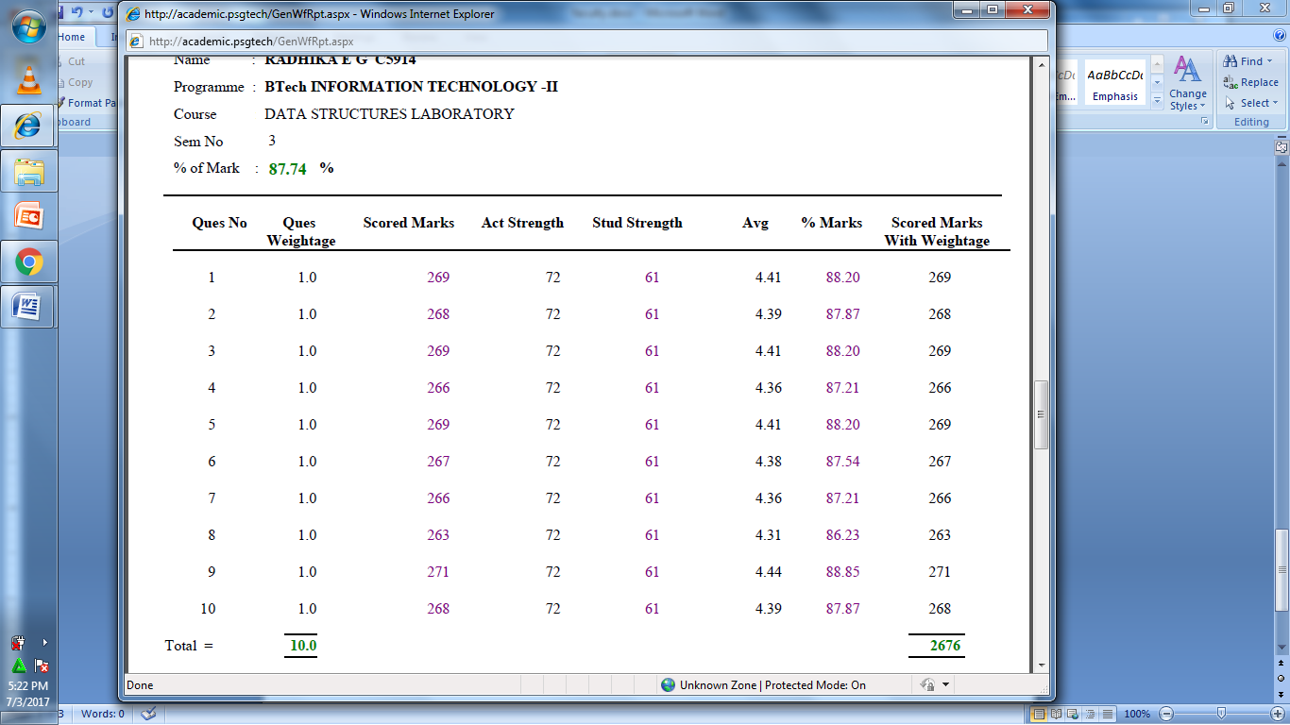
Consolidated Mark List

Slide 13
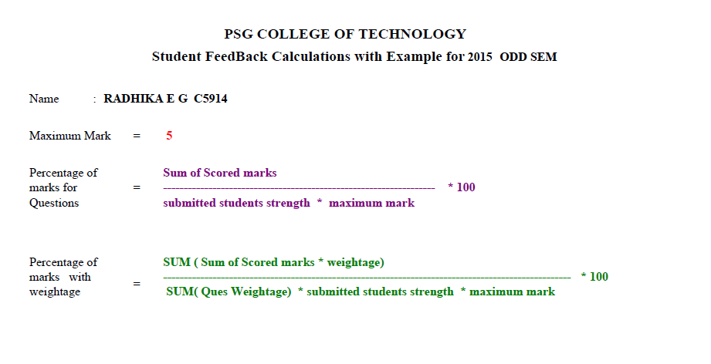


Formula
For each question
$$\frac{269}{61×5}×100=88.2 \%$$
Overall Rating for the subject
$$\frac{\sum{(269+268+ …)}}{\sum{(1+1+..)}×61×5}×100=87.74 \%$$
* Data cited in the previous slide

Slide 14
Proposed Model – Login
Get designation of the user, their corresponding ID and Password.
One of the two cases occurs
Open the online feedback form, if access granted.
Display 'Password Error' message. Direct to Login page.

Slide 15
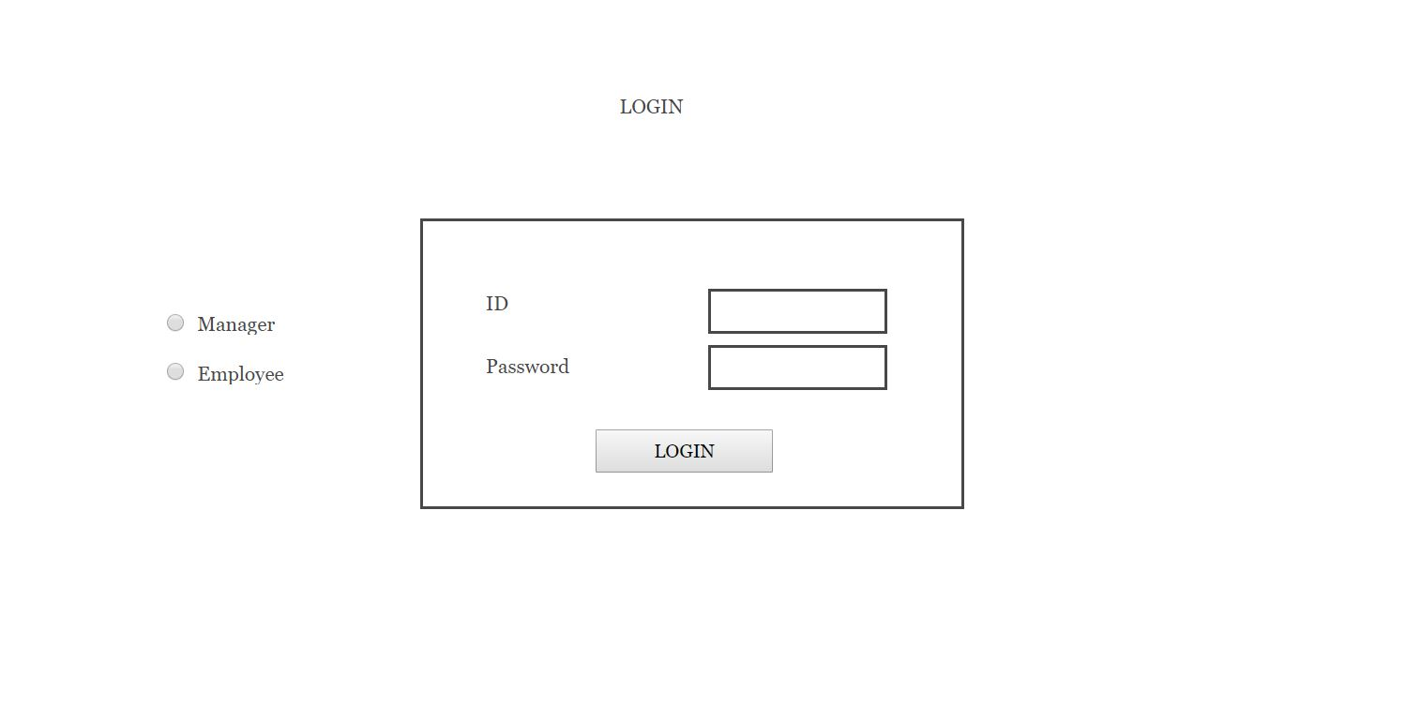
Proposed Model – Login
Further Assesses can also be added

Slide 16
Proposed Model – Feedback Form
Rating Form
Side tab with 'individuals‘ (Managers) to be rated.
Upon Selection of a 'individual',
Fetch their Name and Position
Get input for the various competency set
Classify rating into Self or Superior or Peer or Sub-ordinate.
Beginners get rating from only Superior and Self.

Slide 17
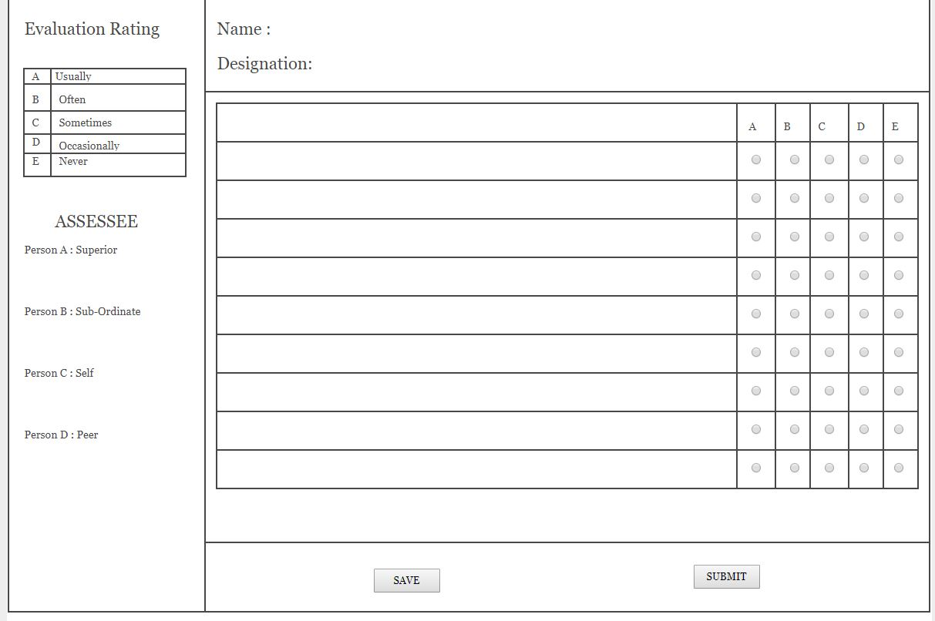
Proposed Model – Feedback Form

Slide 18
Formula
Get input as rating A to E for various competency set
Priority = Importance x Performance Gap
Performance Gap = Current Level of Performance ÷ Desired Level of Performance
(e.g.)
Performance Gap=24 ÷ 55=0.436
Priority = 0.436 * 70%=30.52% (out of 70%)

Slide 19
Result Generation
Calculate Rating in percent.
Classify into
Mentor (Greater than 85%)
Performer (Between 55% to 84%)
practitioner (Between 36% to 54%)
learner (Below 35%)

Slide 20
Report Generation
Can analyze the manager’s performance from the view of employees, peers, suppliers, etc… separately
The report can be generated in different formats
Compare the performance of a manager with other managers, and with his own past performance
Scope for improving specific area

Slide 21
Members
B.Tech INFORMATION TECHNOLOGY
Mr. Adarsh Srikanth :15I204
Mr. Pooventhiran G. :15I228
Mr. Sandeep Arockia :15I243
Mr. Parthiban Sugumar :16I340

